Slide 1
A very general introduction to Geant4: Essentials and Jargon
José A. Ramos Méndez
University of California San Francisco

Slide 2
Outline
Introduction
Kernel: A basic description.
Detector construction: Materials and Geometry.
Physics List.
Particle Source.
Scoring.

Slide 3
Introduction

Slide 4
What is Geant4?
S. Agostinelly, et., Al. Nucl. Inst. and Meths. Phys. Res. A. 506, p250, 2003
J. Allison, et. Al, IEEE Trans. Nucl. Sci, 53(1), p270, 2006
It is a Monte Carlo toolkit to simulate the transport of radiation through matter, first developed for high energy physics.
It is the reference engine for the LHC, SLAC among others.
It is not an application (executable, binary, etc.)
It is C++ object-oriented programming, thus require expertise in physics and programming
Geant4 offers the necessary tools to simulate all the relevant physical process:
  electromagnetics
  Hadronics
  decay
  thermal neutron
  transport of optical photons
  very low energy interactions (DNA)

Slide 5




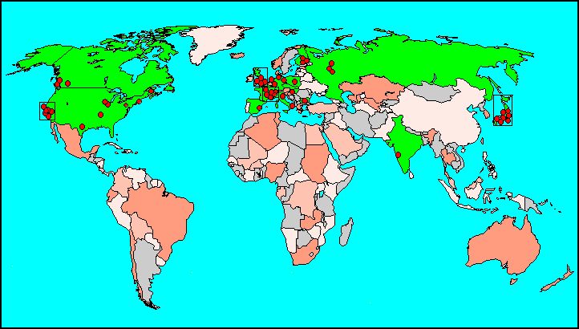


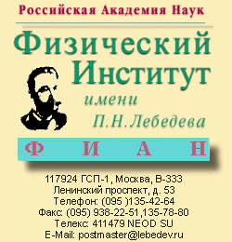






Geant4 Collaboration
TRIUMF
Lebedev
Collaborators also from non-member institutions, including
Budker Inst. of Physics
IHEP Protvino
MEPHI Moscow
Pittsburg University
J.W.Goethe
Universität

Slide 6
How Geant4 can helps me?
Materials and Geometry - G4VUserDetectorConstruction
Particle source - G4VUserPrimaryGeneratorAction
Physics of interaction - G4VUserPhysicsList
Scoring
(x)
x

Slide 7
Basic structure of applications
The applications build on the top of Geant4, usually follow this structure
include/
MyProject/
File_1.hh
...
File_n.hh
src/
The main file organize
the simulation.
Main.cc
File_1.cc
...
File_n.cc
CMAKE look for
dependences, set the
executable file and
create the MakeFile
CMakeLists.txt
Methods inherit from:
G4VUserDetectorConstruction
G4VUserPhysicsList
G4VUserPrimaryGenerationAction
G4ActionInitialization
Others
Optionally, files with
predefined commands used
by the Application can be
created by the user.
macros.mac

Slide 8
C++ with class
MyClass.hh in directory include/
#ifndef MyClass_hh
#define MyClass_hh 1
#include “G4VClass.hh”
#include “globals.hh”
class MyClass : public G4VClass {
public:
MyClass();
virtual ~MyClass();
void AFunction();
void AnotherFunction();
private:
G4double fAVariable;
};
#endif
MyClass.cc in directory src/
#include “MyClass.hh”
#include “G4XXXxxx.hh”
MyFile::MyClass() : G4VClass() {
fAVariable = 0 * MeV;
}
MyClass::~MyClass() {
}
void MiClase::AFunction(){
// Do something interesting
G4cout << “Hello World!” << G4endl;
}
void MyClass::AnotherFunction() {
// Do something interesting
fAVariable += 1 * GeV;
AFunction();
}

Slide 9
C++ with class
How to use MyClass?
#include “MyClass.hh”
...
MyClass* class = new MyClass();
class->AnotherFunction();
...
Inherit methods used in the Main file via runManager:
#include “MyClass.hh”
...
MyClass* class = new MyClass();
// ActionInitialization, Detector and Physics
runManager->SetUserInitialization(class);
...
Due to multithreading, ActionInitialization controls EventAction, SteppingAction, etc.

Slide 10
Kernel: a general description.

Slide 11
Jargon: G4Event
Event: it is a history. In Geant4, the primary particle is transported first, then all the associate secondary particles in order of creation.
G4UserEventAction.

Slide 12
Jargon: G4Run
RUN: collection of events that share the same geometry setup and physical conditions.
“/run/beamOn 4”
G4UserRunAction.

Slide 13
Jargon: G4Run
RUN: collection of events that share the same geometry setup and physical conditions.
“/run/beamOn 4”
G4UserRunAction.

Slide 14
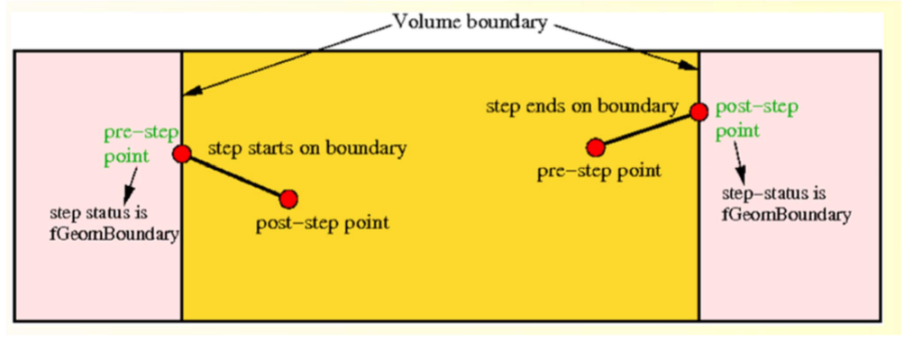
Jargon: Track and Step
G4PreStep
G4Step
G4PostStep
G4Track
Image from Luciano Pandola at INFN-LNGS and LNS
G4Step: stores the transient information of a step - G4UserSteppingAction. The step it is limited not only for the physical interaction but for the geometry as well.
G4Track: keeps information on the final status of the particle after the completion of a step - G4UserTrackingAction.

Slide 15
Jargon: Track and step
G4Step
Pointer to PreStepPoint and PostStepPoint
Geometrical step length (before MSC)
True step length (after MSC)
Increment of position between Pre and Post
Increment of momentum end energy(delta energy) between Pre and Post
Pointer to G4Track
Total energy deposited during the step: Edep by energy loss process + energy lost of secondaries which were not generated because production cut.
Info in G4StepPoint (pre and post)
(x,y,z,t)
(px,py,pz,Ek)
Momentum direction
Pointer to Physical Volumes
Safety
Beta, gamma
Polarization, Step status
Pointer to physics process that defined the step
Global (as in Track) and Local (when the current track was created) time
Proper time.
G4Track
(x,y,z)
Global time (time since the event was created)
Proper time
Momentum direction
Kinetic energy
Accumulate geometrical track length
Accumulate true track length
Pointer to dynamic particle
Pointer to physical volume
Track ID number
Track ID number of parent
Current step number
Track status
Vertex information (position, momentum and kinetic energy
Pointer to the process with created the current track.

Slide 16
Geant4 kernel
Geant4 consists of 17 categories.
  Independently developed and maintained by WG(s) responsible to each category.
  Interfaces between categories (e.g. top level design) are maintained by the global architecture WG.
Geant4 Kernel
  Handles run, event, track, step, hit, trajectory.
  Provides frameworks of geometrical representation and physics processes.
Geant4
Visuali
Readout
Inter
zation
faces
Run
Persis
tency
Event
Tracking
Digits +
Processes
Hits
Track
Geometry
Particle
Graphic
Material
_reps
Intercoms
Global

Slide 17
Geant4 as a state machine
Geant4 has six application states.
  G4State_PreInit
    Material, Geometry, Particle and/or Physics Process need to be initialized/defined
  G4State_Idle
    Ready to start a run
  G4State_GeomClosed
    Geometry is optimized and ready to process an event
  G4State_EventProc
    An event is processing
  G4State_Quit
    (Normal) termination
  G4State_Abort
    A fatal exception occurred and program is aborting
PreInit
initialize
Idle
beamOn
exit
GeomClosed
Run
(event loop)
Quit
EventProc
Abort

Slide 18
Let me remind you…
Define material and geometry
  G4VUserDetectorConstruction
    Material and Geometry lectures
Select appropriate particles and processes and define production threshold(s)
  G4VUserPhysicsList
    Physics lectures
Define the way of primary particle generation
  G4VUserPrimaryGeneratorAction
    Primary particle lecture
Define the way to extract useful information from Geant4
  G4UserSteppingAction, G4UserTrackingAction, etc.
  G4VUserDetectorConstruction, G4UserEventAction, G4Run, G4UserRunAction
  G4SensitiveDetector, G4VHit, G4VHitsCollection
    Scoring lectures

Slide 19
Detector construction: Materials and Geometry

Slide 20
Materials
G4Isotope
G4Element
G4Material
Classes to generate materials from scratch
Density
Temperature (273.15K)
G4Material
State (Solid, gas)
Pressure ( 1e5 Pa)

Slide 21
Materials
G4Isotope(const G4String& name,
G4int z, // atomic number
G4int n, // number of nucleons
G4double a = 0, // mass of mole
G4double m = 0, // isomer level)
G4Element(const G4String& name,
const G4String& symbol,
G4int nbIsotopes)
Or internal database from the NIST:
  #include “G4NistManager.hh”
  G4NistManager* manager = G4NistManager::GetPointer();
G4Element(const G4String& name,
const G4String& symbol,
G4double Zeff,
G4double Aeff)
G4Material(const G4String& name,
G4double density,
G4int nComponents)
For example:
  G4bool iso = false; // Is this an isotope?
  G4Element* C = manager->FindOrBuildElement(“G4_C”, iso);
  G4Element* H = manager->FindOrBuildElement(G4int Z, iso);
  G4Material* Air = manager->FindOrBuildMaterial(“G4_AIR”, iso);

Slide 22
Materials: Example
G4double z, a, abundance, fraction, density;
G4int n;
G4Isotope* U235 = new G4Isotope(“U235”, z=92, n=235, a=235.044*g/mole);
G4Isotope* U238 = new G4Isotope(“U238”, z=92, n=238, a=238.051*g/mole);
G4Element* U = new G4Element(“UEnriched”, “U”, n=2);
U->AddIsotope(U235, abundance=5*perCent);
U->AddIsotope(U238, abundance=95*perCent);
G4Material* Uranium = new G4Material(“Uranium”, density=17*g/cm3, n=1);
Uranium->AddElement(U, fraction=100*perCent);
G4Element* H = new G4Element(“H”, z=1, a=1.001*g/mole);
G4Element* O = new G4Element(“O”, z=8, a=16.01*g/mole);
G4Material* WaterWithUranium = new G4Material(“Water”, density=1.0*g/cm3, n=3);
Water->AddElement(H, fraction=79*perCent);
Water->AddElement(O, fraction=20*perCent);
Water->AddMaterial(Uranium, fraction=0.1*perCent);

Slide 23
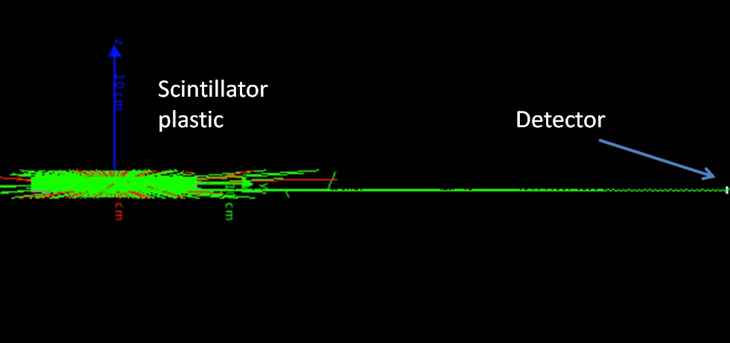
Optical properties
For the transport of optical photons (generated by an electromagnetic process as scintillation or Cerenkov effect).

Slide 24
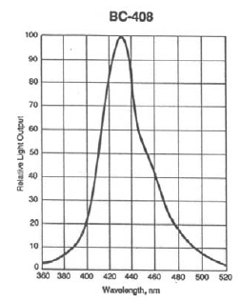
G4MaterialPropertiesTable
const int n = 50;
G4double energy[n] = {2.00*eV, 2.03*eV, ...,
          3.44*eV, 3.47*eV};
          G4double rindex[n] = {1.58, 1.58, ..., 1.58};
          G4double abslength[n] = {210*cm, ..., 210*cm};
          G4double fastComp[n] = {0.0236132, 0.0435086,
          ..., 1.0, ..., 0.0269519};
G4MaterialPropertiesTable* bc408pt= new
G4MaterialPropertiesTable();
bc408pt->AddConstProperty("FASTTIMECONSTANT", 2.1*ns);
bc408pt->AddConstProperty("RESOLUTIONSCALE", 1.0);
bc408pt->AddConstProperty(“SCINTILLATIONYIELD”, 1120/MeV);
bc408pt->AddProperty(“RINDEX”, energy, rindex, n);
bc408pt->AddProperty(“FASTCOMPONENT”, energy, fastComp, n);
bc408pt->AddProperty(“ABSLENGTH”, energy, abslength, n);
matbc408->AddMaterialPropertiesTable(bc408pt);

Slide 25
G4MaterialPropertiesTable
QUANTITY | UNIT | TYPE
RINDEX | NA | Double array
FASTCOMPONENT | NA | Double array
SLOWCOMPONENT | NA | Double array
ABSLENGTH | Length | Double array
MIEGH | NA | Double array
SPECULARLOBECONSTANT | NA | Double array
SPECULARSPIKECONSTANT | NA | Double array
REFLECTIVITY | NA | Double array
WLSABSLENGTH | Length | Double array
WLSCOMPONENT | NA | Double array
QUANTITY | UNIT | TYPE
SCINTILLATIONYIELD | NA | Double
RESOLUTIONSCALE | NA | Double
SLOWTIMECONSTANT | Time | Double
FASTTIMECONSTANT | NA | Double
YIELDRATIO | NA | Double
WLSTIMECONSTANT | Time | Double
MIEHG_BACKWARD | NA | Double
MIEHG_FORWARD | NA | Double
MIEHG_FORWARD_RATIO | NA | Double
material->GetIonisation()->SetMeanExcitationEnergy(Energy);
material->GetIonisation()->SetBirksConstant(value*mm/MeV);

Slide 26
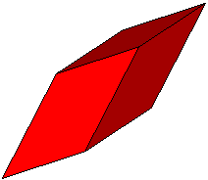



Geometry
A geometric entity is defined by using three classes:
G4VSolid: The Shape (G4Box, G4Tubs, etc.)
G4LogicalVolume: The Material and visualization features (water, color, etc.)
G4VPhysicalVolume: The spatial transformation (location, rotation, replicas, etc.)
Shape | Arguments in G4ABC(“Name”,arg1,…,argN);
G4Box | Name, HLX, HLY, HLZ
G4Tubs | Name, RMin, RMax, HL, SPhi, DPhi
G4Sphere | Name, RMin, RMax, SPhi, DPhi, STheta, DTheta
G4CutTubs | Name, RMin, RMax, HL, SPhi, DPhi, LowNorm, HighNorm
G4Cons | Name, RMin1, RMax1, RMin2, RMax2, HL, SPhi, DPhi
G4Para | Name, HLX, HLY, HLZ, Alpha, Theta, Phi
And many more...
#include “G4Box.hh”
G4Box* box = new G4Box(“aBox”, 0.5*cm, 1.*mm, 2.1*um);

Slide 27
Geometry
G4LogicalVolume( G4VSolid* solido,
G4Material* material,
const G4String& name, G4FieldManager* fieldMgr = 0, G4VSensitiveDetector* SDetector=0,
G4UserLimits* ULimits = 0);
Daughters
World
G4PVPlacement(G4RotationMatrix* rot,
const G4ThreeVector &trans,
const G4String& name,
G4LogicalVolume* logicalVolume,
G4VPhysicalVolume* physMother,
G4bool many,
G4int copyNo,
G4bool surfaceCheck=false);

Slide 28
Particle sources

Slide 29
Particles in Geant4
Particle
G4Track
G4DynamicParticle
G4ParticleDefinition
Position
Geometrical information
Momenta
Energy
Spin
Etc.
Charge
Mass
Live time
Decay channels

Slide 30
G4VUserPrimaryGeneratorAction
We are going to consider two types of generators:
  G4ParticleGun.
  G4GeneralParticleSource.
The users must to create a class inherit from G4VUserPrimaryGeneratorAction

Slide 31
G4ParticleGun
It is an implementation of G4VPrimaryGenerator
It does not provide a kind of default particle source, but all the tools to personalize one.
It can be used as many times as required.
All information regarding the particle must to be set by hand: position, momentum, energy, etc.
G4GeneralParticleSource
It is an implementation of G4VPrimaryGenerator
It allows to define complex sources via commands
http://reat.space.qinetiq.com/gps

Slide 32
Particle source
G4ParticleGun
Simple
One particle at once
Easy to manipulate
Flexible
G4GeneralParticleSource
Powerful
Controlled via commands
Allow to create distributions on surfaces or in volumes
Biasing in energy, direction and position via user-defined histograms
Particle source from a volume or surface? Use GPS
Complex distributions? Use GPS
Flexibility (e.g. phase space)? Use ParticleGun

Slide 33
G4VUserPrimaryGeneratorAction
#ifndef PrimaryGeneratorAction_h
#define PrimaryGeneratorAction_h 1
#include "G4VUserPrimaryGeneratorAction.hh”
class G4ParticleGun;
class G4Event;
class PrimaryGeneratorAction : public G4VUserPrimaryGeneratorAction
{
public:
PrimaryGeneratorAction();
~PrimaryGeneratorAction();
void GeneratePrimaries(G4Event*);
private:
G4ParticleGun* fparticleGun;
};
#endif

Slide 34
G4VUserPrimaryGeneratorAction
#include “PrimaryGeneratorAction.hh”
#include “G4Event.hh”
#include “G4ParticleGun.hh”
#include “G4ParticleTable.hh”
#include “G4ParticleDefinition.hh”
#include “G4SysteOfUnits.hh”
#include “globals.hh”
PrimaryGeneratorAction::PrimaryGeneratorAction() {
fparticleGun = new G4ParticleGun(1);
G4ParticleTable* pt =
G4ParticleTable::GetParticleTable();
G4ParticleDefinition* particle =
pt->FindParticle("proton");
fparticleGun->SetParticleDefinition(particle);
fparticleGun->SetParticleMomentumDirection( G4ThreeVector(0.,0.,1.));
fparticleGun->SetParticleEnergy(3.0*GeV);
}
...

Slide 35
G4VUserPrimaryGeneratorAction
...
PrimaryGeneratorAction::~PrimaryGeneratorAction() {
delete fparticleGun;
}
void PrimaryGeneratorAction::GeneratePrimaries(
G4Event* anEvent) {
// Solo envía un proton de 3 GeV sobre el eje z
fparticleGun->SetParticlePosition(G4ThreeVector());
fparticleGun->GeneratePrimaryVertex(anEvent);
}

Slide 36
Physics list

Slide 37
Physics list
What is the physics list?
  The physics list is the class that contains all the particles, physical process and production threshold required for a simulation.
  It establish how and when to call the physics in a flexible way.
The physics is everywhere. Why don’t offer a default physics list?
  1 There exist a large amount of physical models and approximations
  2 The computational effort would be excessive
  3 Not all the applications need all particles or process that Geant4 offer. e.g. Medical applications (E<500MeV) versus high energy applications (E~TeV)

Slide 38
Physics list
What Geant4 offers:
Electromagnetic physics
  Standard (~1 keV - ~PeV)
  Low energy (250 eV up to ~PeV)
  optical photons (visible spectra)
  Geant4DNA (down to ~eV)
Weak interaction physics
  Decay of subatomic particles
  Radioactive decay of the nuclei
Hadron physics
  Strong force up to ~TeV
  electro-nuclear and gamma-nuclear from 10 MeV - ~TeV
Parameterized physics
For medical applications the electromagnetic physics is almost enough. It offers models for
Photon interaction
  Compton, photoelectric, gamma conversion, Rayleigh scattering, etc.
Electron and positron interactions
  Multiple scattering, stopping, bremsstrahlung, etc.
Proton and neutron interaction
    Stopping via Bethe-Bloch, multiple scattering models.
In addition, we can use radioactive decay for radionuclides.
And Cerenkov, Scintillation, Absorption, etc. for optical photons.

Slide 39

How to use?
void MyPhysicsList::ConstructParIcle() {
G4Electron::ElectronDefinition();
G4Proton::ProtonDefinition();
G4Neutron::NeutronDefinition();
G4Gamma::GammaDefinition();
...
}
void MyPhysicsList::ConstructProcess() {
AddTransportation();
ContructEM();
ConstructGeneral();
}
void MyPhysicsList::ConstructEm() {
G4PhysicsListHelper* ph=G4PhysicsListHelper::GetPhysicsListHelper();
theParticleIterator->reset();
whie( (*theParticleIterator)() ) {
G4ParticleDefinition *particle = new theParticleDefinition->value();
if ( p == G4Gamma::Gamma() ) {
ph->RegisterProcess(new G4GammaConversion(), particle);
... // Add more process
}
// Repeat add process for each particle
}
}
void MyPhysicsList::ConstructGeneral() {
G4PhysicsListHelper* ph = new G4PhysicsListHelper::GetPhysicsListHelper();
G4Decay* theDecay = new G4Decay();
theParticleIterator->reset();
while( (*theParticleIterator)()) {
G4ParticleDefinition* particle = theParticleIterator->value();
if ( theDecayProcess->IsApplicable(*particle) ) {
ph->RegisterProcess(theDecayProcess, particle);
}
}
} // More physics
void MyPhysicsList::SetCuts() {
fdefaultCutValue = 0.7 * mm;
SetCutValue(defaultCutValue, “gamma”);
SetCutValue(defaultCutValue, “e-”);
SetCutValue(defaultCutValue, “e+”);
SetCutValue(defaultCutValue, “proton”);
}

Slide 40
The G4VModularPhysicsList
In more complex situations, trying to create the physics list as shown before become unpractical hard to maintain in order to keep the code update.
Thus Geant4 offer the so called modular physics list which is inherit from G4VUserPhysicsList. It is
  It is stable
  Allow us to combine models in a modular way
  AddTransportation() method for all the registered particles
  It is considered the “reference physics list”
#include “G4EMStandardPhysics_option3.hh”
#include “G4DecayPhysics.hh”
..
RegisterPhysics( new G4EMStandardPhysics_option3());
RegisterPhysics(new G4DecayPhysics());

Slide 41
G4VModularPhysicsList
RegisterPhysics(new MyPhysicsModule())
Hadron inelastic (cont.)
G4HadronPhysicsFTFP_BERT_HP
G4HadronPhysicsQGSP_BIC_AllHP
G4HadronPhysicsFTFP_BERT_TRV
G4HadronPhysicsQGSP_BIC_HP
G4HadronPhysicsFTF_BIC
G4HadronPhysicsQGSP_FTFP_BERT
G4HadronPhysicsINCLXX
G4HadronPhysicsQGS_BIC
G4HadronPhysicsNuBeam
G4HadronPhysicsShielding
G4HadronPhysicsQGSP_BERT
Ions
G4IonBinaryCascadePhysics
G4IonPhysics
G4IonINCLXXPhysics
G4IonQMDPhysics
Stopping
G4StoppingPhysics
Electromagnetics
G4EmDNAChemistry
G4EmDNAPhysics
G4EmDNAPhysics_option1
G4EmPenelopePhysics
G4EmLowEPPhysics
G4EmLivermorePhysics
G4EmLivermorePolarizedPhysics
G4EmStandardPhysics
G4EmStandardPhysicsSS
G4EmStandardPhysicsWVI
G4EmStandardPhysics_option1
G4EmStandardPhysics_option2
G4EmStandardPhysics_option3
G4EmStandardPhysics_option4
G4EmLEPTSPhysics
G4OpticalPhysics
Decay
G4DecayPhysics
G4RadioactiveDecayPhysics
Gamma-lepto-nuclear
G4BertiniElectroNuclearBuilder
G4EmExtraPhysics
Hadron elastic
G4ChargeExchangePhysics
G4HadronElasticPhysicsPHP
G4HadronDElasticPhysics
G4HadronElasticPhysicsXS
G4HadronElasticPhysics
G4HadronHElasticPhysics
G4HadronElasticPhysicsHP
G4IonElasticPhysics
G4HadronElasticPhysicsLEND
Hadron inelastic
G4HadronInelasticQBBC
G4HadronPhysicsQGSP_BERT_HP
G4HadronPhysicsFTFP_BERT
G4HadronPhysicsQGSP_BIC

Slide 42
Scoring

Slide 43
Command based scoring
It uses the concept of parallel world to overlay a grid over the geometry and to recover tallies without infer with the physics.
It has not a high performance, but it is easy to use and it is compatible with multithreading.
cell(i,j)
The shape and name of the grid (box & cylinder)
The size of the grid (similar a G4Box/G4Tubs)
The binning (bins)
Optionally the translation and rotation (by default it is centered with respect to the world)

Slide 44
Use
#include “G4ScoringManager.hh”
int main( int argc, char** argv ) {
G4RunManager* runManager = new G4RunManager();
G4ScoringManager* scManager =
G4ScoringManager::GetScoringManager();
scManager->SetVerboseLevel(1);
/score/create/boxMesh myScorer
/score/mesh/boxSize 1.0 1.0 15.0 cm
/score/mesh/nBin 1 1 60
/score/quantity/doseDeposit dDose
/score/filter/particle gammaFilter gamma
/score/close
/score/list
/run/beamOn 100

Slide 45
Command-based scoring
energyDeposit
cellCharge
passageCellFlux
doseDeposit
nOfStep
nOfSecondary
trackLength
passageCellCurrent
passageTrackLength
flatSurfaceFlux
nOfCollision
population
nOfTrack
nOfTerminatedTrack
Filter the scoring by particle:
  charged
  neutral
Particle’s incoming kinetic energy:
  /score/filter/kineticEnergy
  <name> <eLow> <eHigh> <unit>
Particle’s type:
  /score/filter/particle
  <name> <pname1> ... <pnamen>

Slide 46
Stepping-based scoring
We can use an inherit class from G4UserSteppingAction to get the information of the particle at every step in the world.
This is time consuming, but the G4Region can be used to restrict the scoring to specific regions.
All information in G4Step, G4StepPoint and G4Track can be accessed from here.

Slide 47
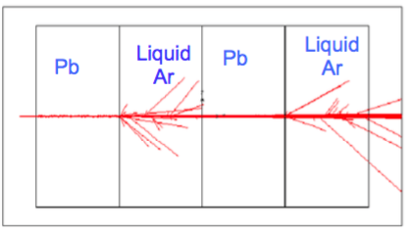
Stepping based scoring
SteppingAction::UserSteppinAction(const G4Step* step) {
if (step->GetTrack()->GetVolume()->
G4LogicalVolume()->GetRegion() == myRegion ) {
// Save info here
G4cout << step->GetTrack()->GetKineticEnergy()/MeV;
G4cout << step->GetPreStepPoint()->GetPosition();
}
}
A note on regions and production cuts
G4Region can be used to assign a specific production cut per volumes.
Various volumes can be part of a region.
Cuts are defined in units of length, so they are internally converted to energy accordingly. E.g. a unique PC=1.5 mm is
  455 keV for e- in Ar
  2 MeV for e- in Pb.

