Slide 1
Basics of Monte Carlo Simulation
José A. Ramos Méndez, PhD.
University of California San Francisco

Slide 2
Outline
Introduction
Basics of Monte Carlo method
Statistical Uncertainty
Improving Efficiency Techniques

Slide 3
Introduction

Slide 4
What is the Monte Carlo method?
“The Monte Carlo method is a numerical solution to a problem that models objects interacting with other objects or their environment based upon simple object-object or object- environment relationships. It represents an attempt to model nature through direct simulation of the essential dynamics of the system in question. In this sense the Monte Carlo method is essentially simple in its approach—a solution to a macroscopic system through simulation of its microscopic interactions”
Alex F Bielajew in “Funtamentals of the
Monte Carlo Method for neutral and charged particle
transport” Available on line

Slide 5
A short review of MC history
A first reference with Comte de Buffon, 1777
The seminal paper of Metropolis and Ulam, 1949
Berger’s contribution to charged particle transport, 1963
A needle intersects a line if:
y
L
θ
The probability of cross a line
D
Notes:
Later, Laplace suggested that this procedure could be employed to determine the value of π, albeit slowly.
Ulam and von Neumann coined the phrase “Monte Carlo” and were pioneers in the development of the Monte Carlo technique and its realizations on digital computers

Slide 6
Keep in mind that…
Random sampling
Probability density
function
Statistical uncertainties
A history
λ’₁
λ₁
λ₂
λ’’₁

Slide 7
… and that…
More accurate physical
models or more detailed
geometries.
Statistical uncertainties
(physics, geometry, etc)
Long time execution
Variance reduction,
Multithreading, GPU.

Slide 8
The eternal question
Problem
Monte Carlo
Det.
Monte Carlo
Or
Deterministic?
What do I want to accomplish?
What is the most efficient way to do it?
Notes:
There are, however, two inescapable realities. The first is that macroscopic theory, particu- larly transport theory, provides deep insight and allows one to develop sophisticated intuition as to how macroscopic particle fields can be expected to behave. Monte Carlo can not compete very well with this. In discovering the properties of macroscopic field behaviour, MonteCarloists operate very much like experimentalists. Without theory to provide guidance the
process of discovery is trial and error, guided perhaps, by some brilliant intuition.

Slide 9
Basics of The Monte Carlo Method

Slide 10
Outline
Uncertainties
Efficiency
Scoring
Monte Carlo
PDFs
Sampling
RNGs

Slide 11
Outline
Uncertainties
Efficiency
Scoring
Monte Carlo
PDFs
Sampling
RNGs

Slide 12
What is a PDF?
Probability distribution functions (PDFs)
Restrictions:
In Physics a PDF can represent the most likely spatial position, kinetic energy, momentum direction, etc., of a particle.
The PDF can be obtained by either theoretical models and parameterization to experimental data, such as cross sections, etc.

Slide 13
But PDFs are hard to use…
The domain of such functions is so diverse.
Fortunately, associate to each PDF there exists a Cumulative Distribution Function (CDF)
Features:

Slide 14
In the practice, we use the discrete form of PDF and CDF
Discrete PDF
p₃
p(x)
p₁
p₄
p₂
p₅
x₁
x₂
x₃
x₄
x₅
Discrete CDF
c(x)
p₁+p₂
p₁
x₁
x₂
x₃
x₄
x₅

Slide 15
Outline
Uncertainties
Efficiency
Scoring
Monte Carlo
PDFs
Sampling
RNGs

Slide 16
(Pseudo)Random numbers
Non-correlated sequences of numbers generated by an iterative equation.
Repeatability after a very long number of random numbers.
Non-uniform sequence.
Reproducible: “seed”.
I_{j+1} = (aI_{j} + c) mod m
where:
a = 663608941
c = 0
m = 2³²

Slide 17
Where to use random numbers?
In the practice, we can generate uniform random numbers in [0, 1].
But we need random numbers that obey the PDF of the physical process we want to simulate. These numbers are not uniform!
Sampling techniques allow to recover such numbers from:
  Analytical distribution: theoretical models
  Tabulated distribution: experimental data

Slide 18
The idea behind sampling
The idea is easy, that’s why the MC is so popular and widely used.
At the beginning the Monte Carlo method was developed to solve integrals.
Integrals are the solution to the Boltzmann transport equation, that describes the trajectories of the radiation in matter.
(x)
A
x
a
ξ₁
ξ₂
b

Slide 19
Outline
Uncertainties
Efficiency
Scoring
Monte Carlo
PDFs
Sampling
RNGs

Slide 20
Sampling Techniques: The Direct Method

Slide 21
Sampling Techniques: The Direct Method
In general: r is a uniformly distributed random!

Slide 22
For example
The Cauchy distribution

Slide 23
For example
The Cauchy distribution
Direct method:

Slide 24

Sampling Techniques: The rejection Method
How it works:
1. Estimate p(x_{max})
2. Choose r₁ in [0,1] and set
x’ = a + ( b - a ) r₁
3. Choose r₂ in [0,1]
4. If r₂ < p(x’)/p(x_{max})
Accept x’
5. Else
Reject and repeat step 2
Note that:
This method is useful if c⁻¹ is not easy to determine
p(x_{max}) is not so difficult to determine. If not, then overestimate it (works but not efficient)
p(x) is not infinite in anywhere

Slide 25
For example
The Cauchy distribution
Rejection method:
1.
2.
3. If
Accept x’
Else
Reject x’
go to step 2

Slide 26
For example
The Cauchy distribution
The shift is due to
The width of the histogram’s binning
The simple random generator
I_{j+1} = (aI_{j} + c) mod m
where:
a = 663608941
c = 0
m = 2³²

Slide 27
Outline
Uncertainties
Efficiency
Scoring
Monte Carlo
PDFs
Sampling
RNGs

Slide 28
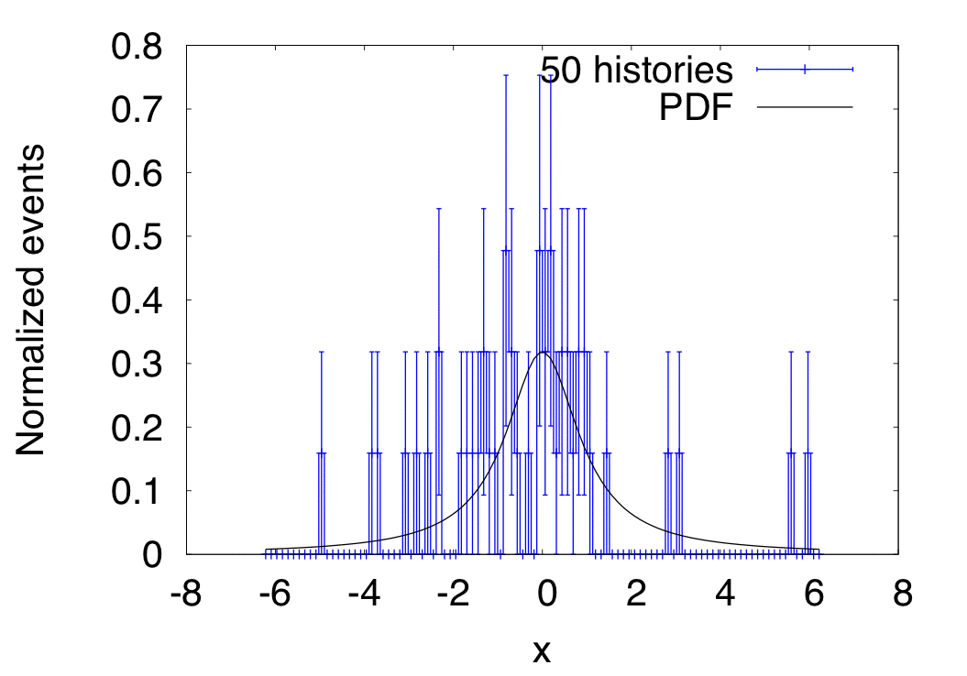
The error estimation
Let us consider a sampling set from the Cauchy distribution

Slide 29
The error estimation
As the number of histories increases, the mean value of the estimated x goes towards the true mean of the PDF
This result is know as the Law of large numbers.
Further, the statistical uncertainty is reduced as N_{h} increases

Slide 30
The central limit theorem
How many histories do I need?
M. H. Kalos and P. A. Whitlock. Monte Carlo methods, Volume 1: Basics. John Wiley & Sons, New York, 1986

Slide 31
Outline
Uncertainties
Efficiency
Scoring
Monte Carlo
PDFs
Sampling
RNGs

Slide 32
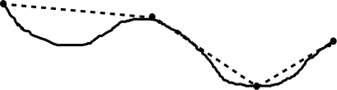
Efficiency enhancing
Analog Monte Carlo
Time line
A physical interaction occurs here. The corresponding type of process and subsequent states of the particle are determined by PDFs.
Condensed transport
Condensed trajectory
Step length
True trajectory

Slide 33
Computational efficiency
The variance is reduced as N_{h} increases
Good news!
The CPU increases as N_{h} increases
Bad news
There is a tradeoff between the variance and the CPU time:
The computational efficiency (CE) takes into account the effect of both the variance and the CPU time.
Increasing CE by reducing variance: Variance reduction techniques¹
Increasing CE by reducing CPU time: Approximate enhancing improving techniques²
¹Unbiased results
²Biased results

Slide 34
Variance reduction techniques
Enhanced cross section, particle splitting and Russian roulette
Useful when secondary particles are of interest, but their production is low frequent, e.g Bremsstrahlung
γ(w₀/f)
γ(w₀)
γ(w₀/f)
σ_{Brems}
f σ_{Brems}
γ(w₀/f)
γ(w₀/f)
e⁻
γ(w₀/f)
γ(w₀/f)
Scoring region
Target
Notes:
Important when secondary particles are of i

Slide 35
Variance reduction techniques
Enhanced cross section, particle splitting and Russian roulette
γ(w₀/N_{s})
γ(w₀)
X
γ(w₀/N_{s})
γ(w₀/N_{s})
X
X
γ(w₀/N_{s})
e⁻
γ(w₀/N_{s})
If not points toward Region
If UniformRand() < 1-1/N_{s}
Terminate track
Else
w_{i} = N_{s}*w₀
Continue track
Scoring region
Target

Slide 36
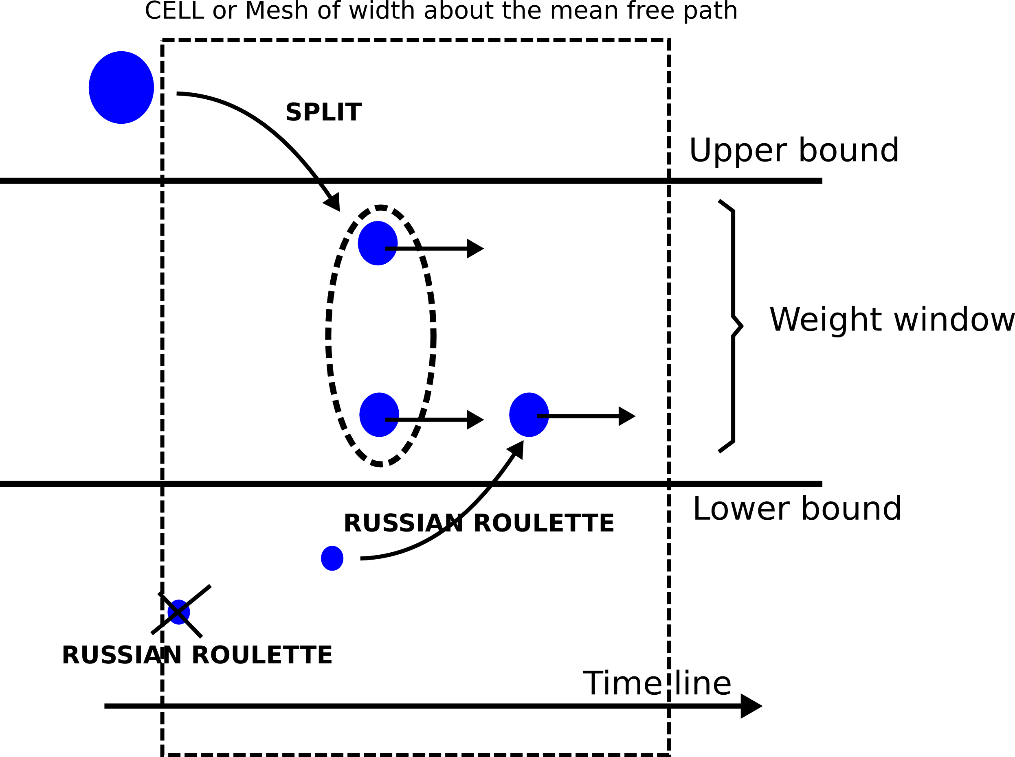
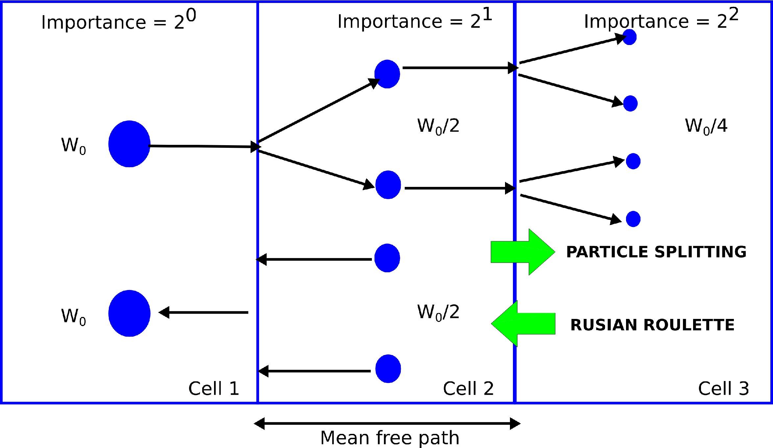
Variance reduction techniques
Importance sampling and weight window.
Useful for enhance the penetration of particles through dense media: shielding.

Slide 37
Approximate efficiency enhancing techniques
Range rejection and production cuts
Expected range lower than user-defined threshold; thus do not create
Region 1
Scoring Region
Transport
Particle
Projected
range
Terminate
transport
Transport
They are used to reduce the CPU by eliminating or not creating secondary particles of low interest. But this methods can bias the result, then use with caution.

Slide 38
Useful reading
Alex F Bielajew’s “Fundamentals of the Monte Carlo method for neutral and charged particle transport”. http://www-personal.umich.edu/~bielajew/MCBook/book.pdf
Numerical recipes. The art of scientific computing. http://www.nr.com
Donald Knuth “The art of computer programming”
Joao Seco and Frank Verhaegen “Monte Carlo Techniques in Radiation Therapy” William R Hendee, CRC Press. 2013
Chetty et. Al. Report of the AAPM TG No. 105. Med. Phys. 34(12) 4818-4853, 2007

